Slide 1
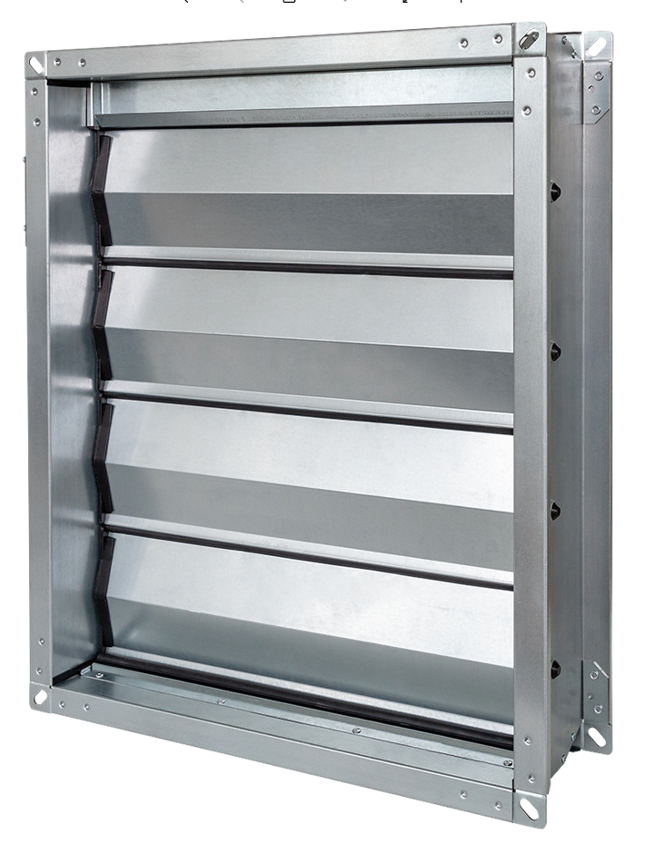
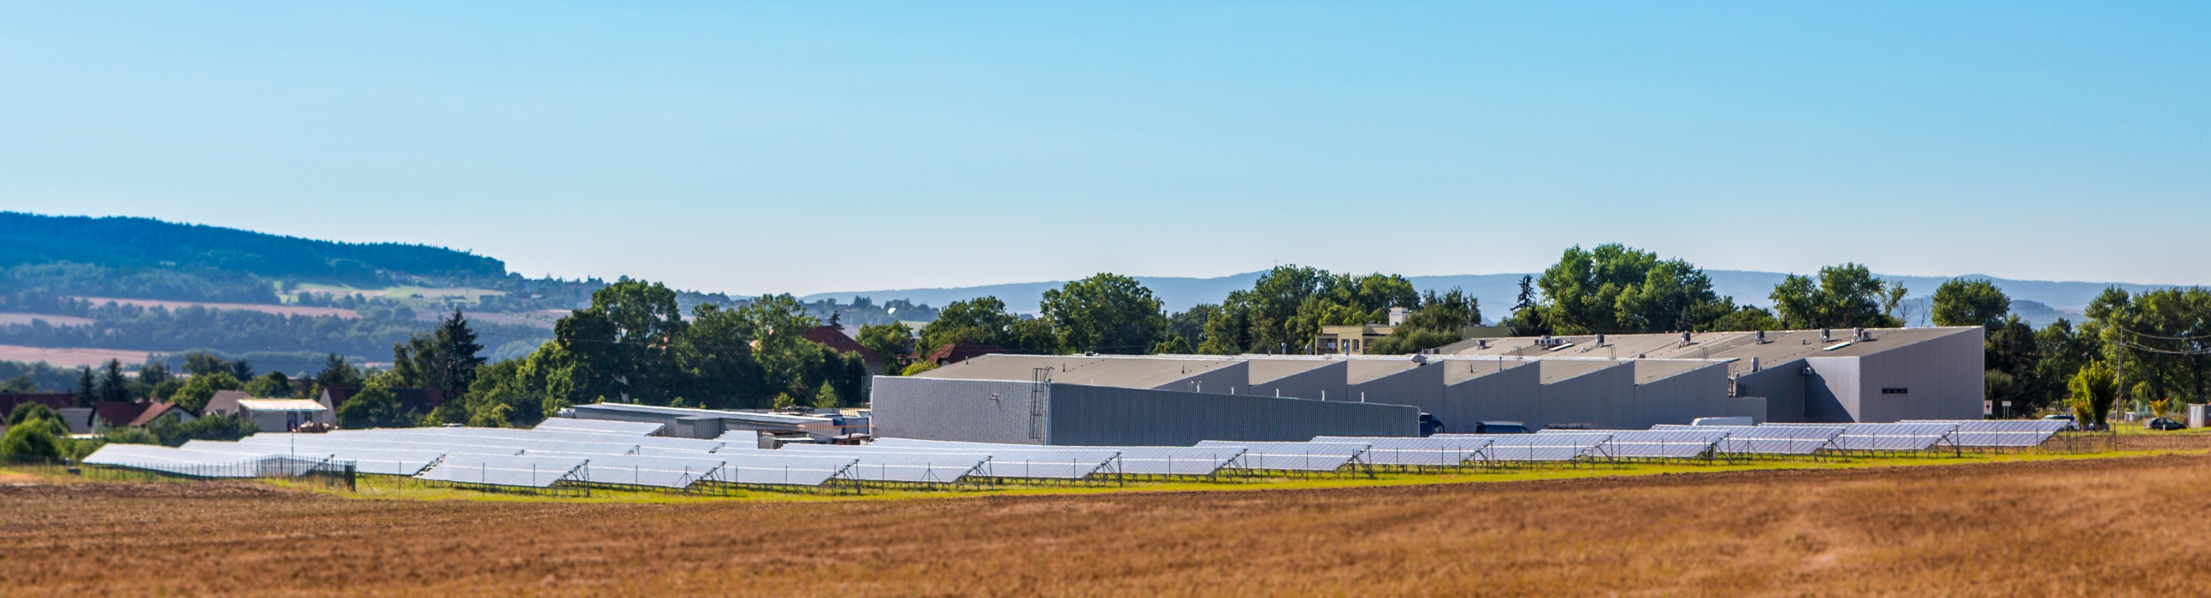
New models RDM and RDTM
Mandík regulating dampers
January 2022

Slide 2
RDM and RDTM are new models of multiblade regulating dampers
single drive (only one actuator per damper) from 200x200 up to 2000x2000mm
only small size of actuators needed
tightness class 3C
silicon-free design
rhombus, aerodynamic and rigid blade profile rounded-edge on flange corners

Slide 3
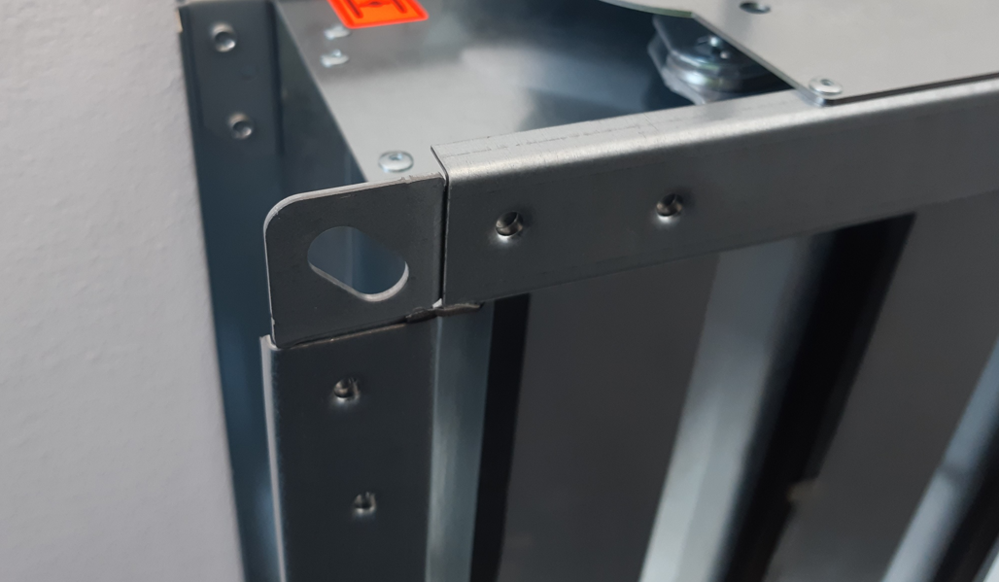
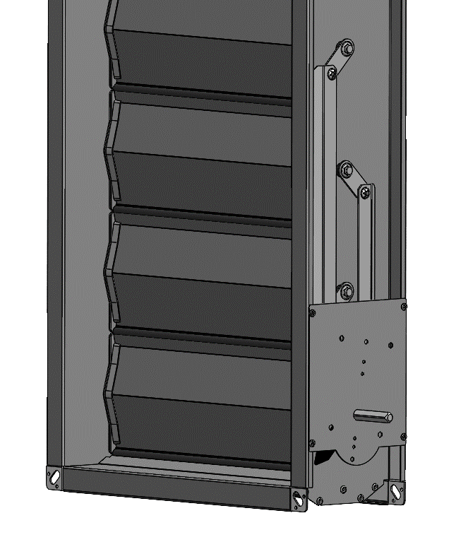
Technical description - advantages
  Steel rods mechanics
  30 mm flange with 9 mm bend for C-profile easy installation
  rounded flange corners with mounting hole
  10x10mm connecting pin for different kinds of actuators
  rounded flange corners with oval monting hole, connection to its flanges with
  „clinching technology joint“, instead of „spot welding“
  Aerodynamic shape of blades, made of galvanized or stainless steel
  Composite end-caps on blades
  Rubber EPDM - in between blades gasket (on air-tight RDTM only),
  instead of „silicone based“ rubber
  sliding end-cup gasket from high-tech EPDM foam with closed cells

Slide 4
RDTM (air-tight) versus RDM (non air-tight) damper
 | RDTM regulating damper (tight) | RDM regulation damper
EN 1751 casing tightness | class C | class C
EN 1751 closed blade tightness | class 3 | N/A (damper not tight)
Torque of actuators | 5 to 40 Nm | 2 to 20 Nm

Slide 5
Technical description - advantages
  counter-running blades
  2 standart blade´s sizes to optimize the effective cross section
  blades with 95 mm span (2 to 4 blades per damper)
  blades with 145 mm span (3 to 13 blades per damper)
  rhombus shape of blades, bent from a single sheet of metal
  blade end-cap gaskets from high-tech closed-cells EPDM foam with a sliding layer
  dampers can be made of galvanized or stainless / 304 / 316L steel
  160 mm casing length (depth) with 30 mm flange (with 9 mm bend)
  Allowance of 12 m/s max air velocity in the duct
  mechanical casing assembly in corners by „clinching“ instead of spot welding
  halogen free, not flammable, UV stabilized composite components (UL-94 class V0)
  preferred blade-axis orientation is horizontal

Slide 6
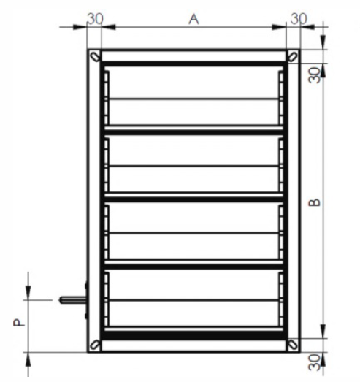
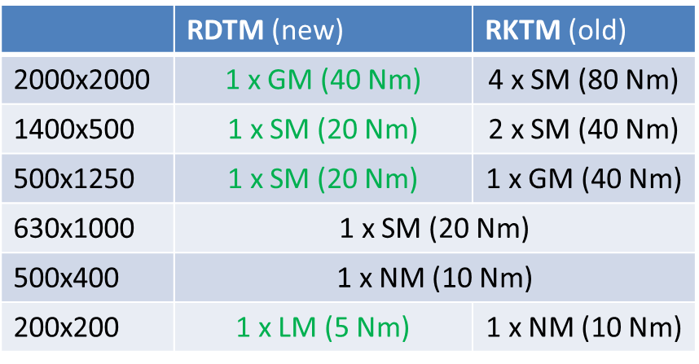
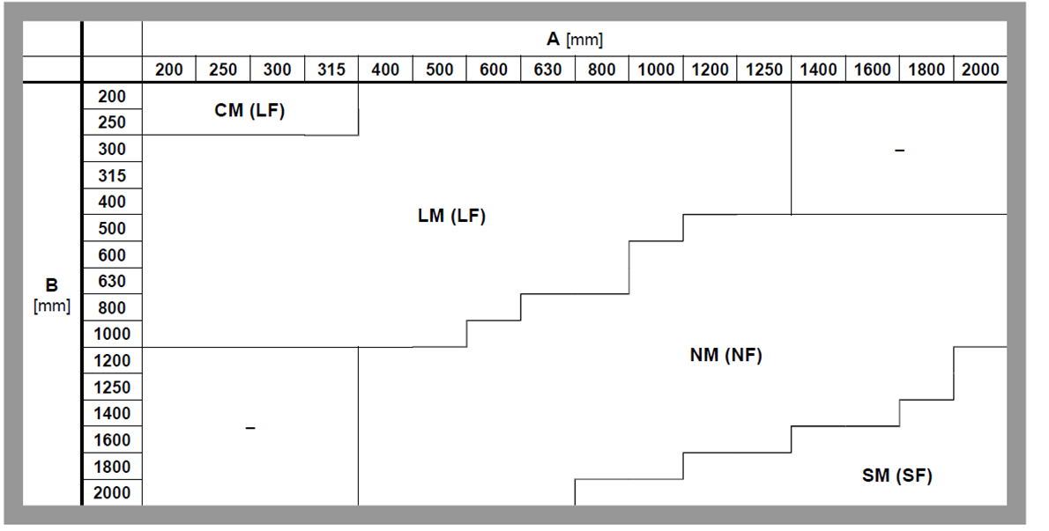
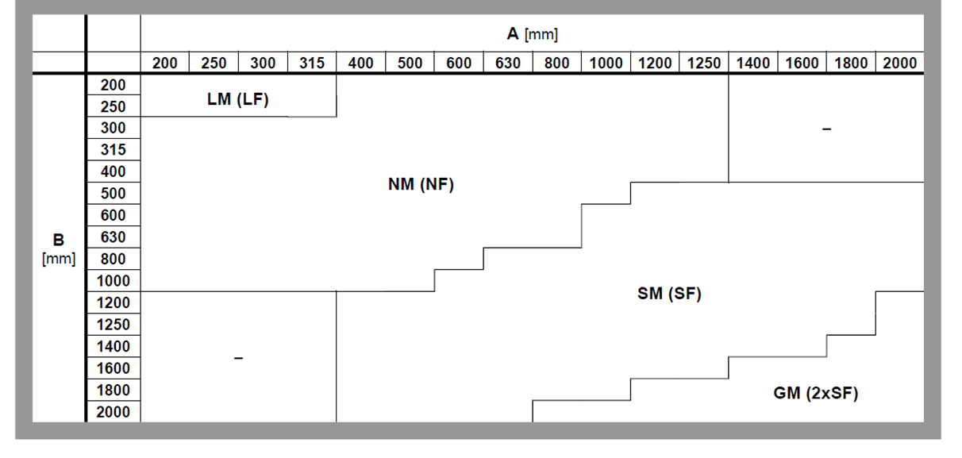
RDM and RDTM – smaller size and less actuators, comparison to old RKTM
RDM RDTM

Slide 7
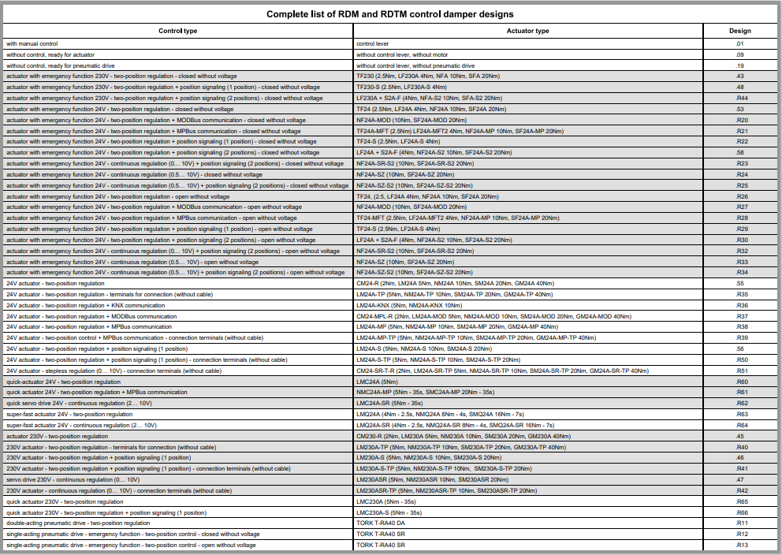
Many designs available

Slide 8
More information will be published on our web page www.mandik.com from 1.2. 2022

